Slide 1
Dharur mint : Some new copper coins of Mughal rulers
Dr.Abhishek Chatterjee
World Of Coins – October 2022 Grand event

Slide 2
Mughal copper
‘Mughal coppers are abundant but good Mughal coppers are rare’
Scope for research
Money of the common man
Later Mughal coppers after Aurangzeb are scarce due to paucity of copper coins in general.
Most copper coins were minted during periods of turmoil and power transfer

Slide 3
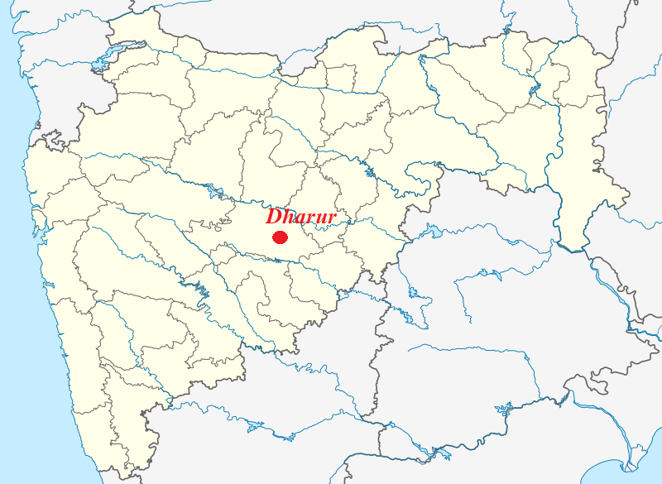
Dharur
Dharur is a city and a municipal council in Beed district in the state of Maharashtra, India
Kille Dharur or Fort of Dharur is located at 18.82°N 76.12°E. It has an average elevation of 739 metres (2424 feet).

Slide 4
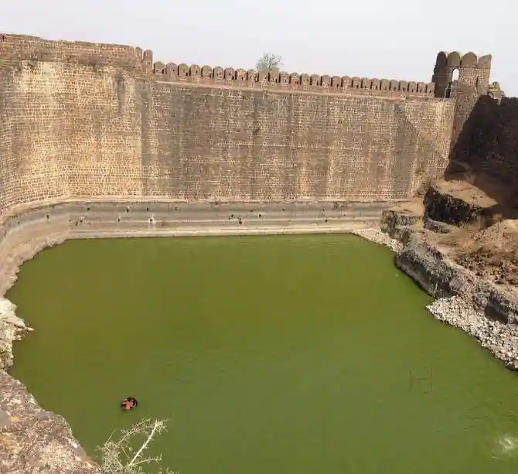
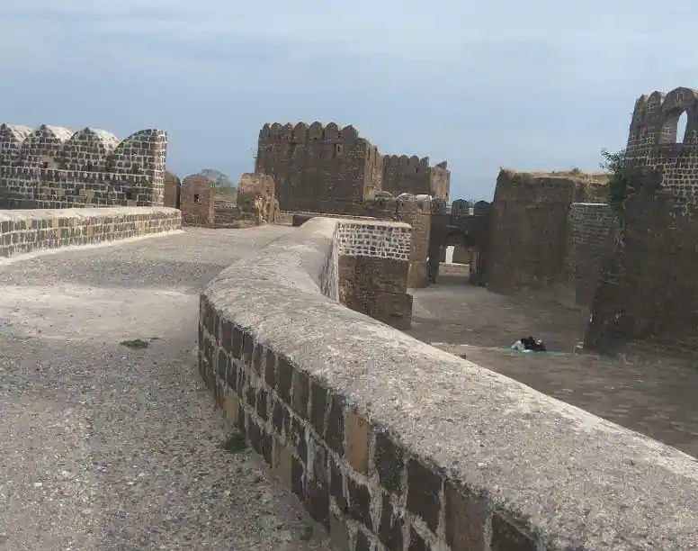
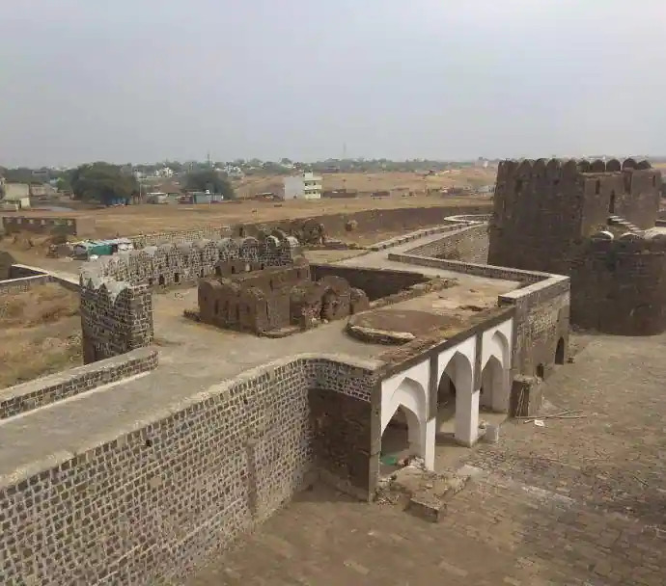

Slide 5
Mughal control of Dharur
In 1630 Khan Jahan Lodhi, the Afghan subadar of Deccan under the Mughals rebelled against Shah Jahan and sought refuge with Nizamshahi kngdom. The freshly proclaimed king executed the Deccan campaign with great enthusiasm and under the command of various generals and he stationed himself at Burhanpur to keep a close watch.
The first palce to be annexed was Dharur and it was renamed Fatehabad. Dharur was a town of strategic importance situated on a trade route that traversed the Balagat hills towards Telingana (present Andhra Pradesh). The secure fort at Dharur on top of a ridge was built by Kisvar Khan Lari, in 1567 AD a commandar at Ali Adil Shah of Bijapur. Shah Jahan invested it under the command of ‘Azam Khan’ the subadar of Deccan. After a brief but bloody encounter the garrison commander Sidi Salim surrendered the fortress of Dharur to the Mughals in January 1631

Slide 6
Shah-Jahan’s general Azam Khan captures the fort at Dharur in January 1631.
Dharur was an important market town, and according to the Padshahnamah text, was renowned ‘for its impregnability and ability to withstand siege, it being situated atop a hill with streams on two sides.’ The text also refers to the capture of three elephants that wondered into the ditch around the fortress and the scaling of the walls by ladders and ropes, details of which are depicted in this scene. The Mughal general, Azam Khan, is the principal figure on horseback on the right of the painting.
Painted by Balchand- Padshahnama

Slide 7
Dharur – Copper coin
Amjad Ali published a copper coin minted in the nameof Shah Jahan in Numismatic Digest (Vol VIII) 1984. He read the mint name as Junnar.
Prashant Kulkarni rectified it to ‘Dharur’ in the subsequent edition in a letter to the editor
Shailendra Bhandare in his article ‘Numismatic Vestiges of Shah Jahan’s deccan campaign’ published in JONS 162 (Winter 2000) illustrated a coin from the cabinet of Mr.Pradeep Sohoni weighing 9 grams

Slide 8
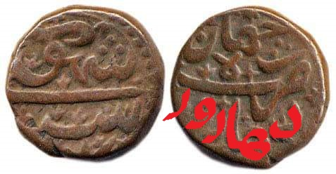
Coin published in JONS newsletter- 162 by Shailendra Bhandare weighing 9 gms (Note- Dharur in red)

Slide 9
Dharur- Copper coin
Shailendra Bhandare observed that the copper coins followed the nizamshahi weight standard and thus 9 gm coin would represent the 2/3rd falus while the coin published by Amjad Ali would represent 1/3rd falus
Subsequently ½ falus (6.2gms) and Falus (13.6gms) are also discovered. Thereby completing all denominations in Nizamshahi weight standard

Slide 10
Shah Jahan Dharur- 1/3rd falus- 6.2 grams (Sudesh Shah- Jalgaon)

Slide 11
Shah Jahan Dharur- Falus- 13.6gm (Personal collection)

Slide 12
Dharur- Copper coins
No coin of the subsequent Mughal emperor Aurangzeb is known although he spent a majority of his life in deccan
Silver coins of Shah Alam I (Aurangzeb’s son) is known and was first published by Alfaaz Hussain Makda in 2017 dated 1124AH/Ry6
I hereby report the copper coin of this ruler

Slide 13
Shah Alam I- Dharur- 13.7gms

Slide 14
Obverse- Sikka Mubarak Shah Alam Bahadur Badshah Ghazi Reverse- Falus zarb Dharur

Slide 15
Dharur- Copper coins
This renewed coining of copper coin from the mint is associated with gifting most of the district of Beed including Dharur to one Nemaji Jadhav by Shah Alam Bahadur in AD1709 as reward for assisting him. The coin discussed is so far only known
Although during Jahandar Shah’s reign silver rupee was minted, so copper coin has yet been found.

Slide 16
Dharur- Copper coins
Dharur remained under Mughal control under Farrukhsiyar, the succeeding Mughal emperor. Silver coins were well known and listed in most catalogues.
Farrukhsiyar appointed one of the Sayyid Brother Syed Hussain Ali Khan as governor of Deccan in 1719 (Ry2) and it seems that Dharur mint was active during that time
A few copper coins were found recently in 2021 and I hereby report one in my collection

Slide 17
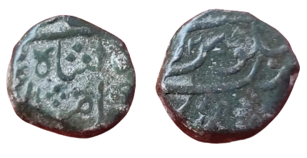
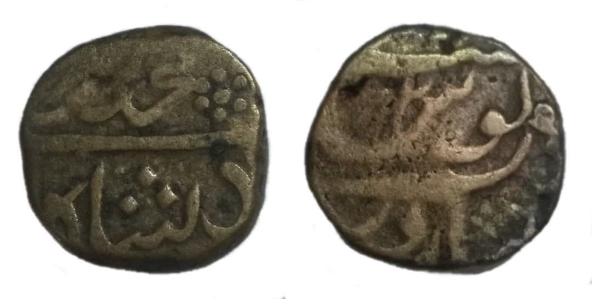

Slide 18
Obverse- Muhammad Farrukhsiyar Badshah ghazi sikka Mubarak Reverse- Zarb Dharur Julus 2 maimanat manus

Slide 19
Dharur- Copper coins
The mint seems to have gone inactive after the stormy period of Syed Hussain Ali Khan when it seems to have passed unto the Nizam of Hyderabad who controlled the fort till 1948 except for a brief period of 3 years between 1760 and 1763 when Marathas were in charge.
However I have discovered a solitary copper coin in the name of Muhammad Shah with clear mint name. Dharur was also one of the bases for Nizam’s movement during the Battle of Palkhed. Whether it was minted during that time is speculative at best.

Slide 20
Muhammad Shah- Dharur- 19.8gms

Slide 21
Obverse- (bad)shah Muhammad Shah Reverse- Zarb Dharur

Slide 22
Mughal coppers
As illustrated in the presentation, there are a lot of scope for research in Mughal coppers. Tracing a mint through various rulers can add to the history of that place and provide evidences for periods of turmoil
The only thing that Mughal coppers need is passion for history and keeping eyes open when a collector gets a lot

