Slide 1
Mughal copper coins from Parenda
World of coins – March 2023
Dr.Abhishek Chatterjee

Slide 2
Parenda
Paranda Fort is situated in Paranda, a small town in the Osmanabad district in the state of Maharashtra, India.
Paranda has great historical value and finds mention in Honnati inscription of Baka 1045 (A.D. 1924) and also later a few of the Kalyan Chalukyan an copper plates. As well as in Yadava epigraphs, as Pallyanda Pratyandaka
The fort as well as the surrounding town may have been constructed in the 15th century by Mahmud Gawan, the prime minister of Bahmani sultan Muhammad Shah II in the late 1470s.
From the crumbling of the Bahmani empire, the fort passed unto the Nizamshahi of Ahmednagar in 1490

Slide 3
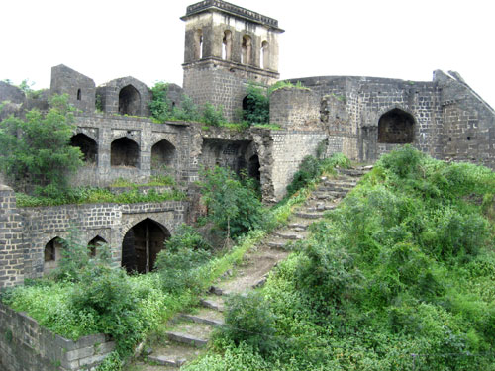

Slide 4
Parenda
The centre of the Nizamshahi empire was Ahmednagar in Maharashtra. No coins are known from Parenda mint for the early Nizamshahi rulers for a century
But the influence of the Mughal rulers from the north threatened he existence of the empire. Akbar under the leadership of his son Murad, there was a campaign against Nizamshahi sultans in 1594. Chand bibi who acted as regent of the infant sultan repulsed the Mughal attack. She kept her independence till her death in 1600AD.

Slide 5
Parenda
Chand bibi’s death in 1600, invited another attack from the Akbar (Mughal) under his son Daniyal and this time Ahmednagar fell and the infant son of Chand bibi was imprisoned
Ahmadnagar city and its adjoining areas were occupied by the Mughals, an extensive part of the kingdom still remained in possession of the influential officials of the Nizam Shahi dynasty.
Malik Ambar and other Ahmadnagar officials defied the Mughals and declared Murtaza Nizam Shah II as sultan in 1600 at a new capital Paranda. Malik Ambar became prime minister and Vakil-us-Saltanat of Ahmadnagar.

Slide 6
Parenda
Parenda being the capital of the remaining Ahmednagar sultanate now, had a mint and minted coins in the name of Murtaza Nizam Shah II. Murtaza Nizam II who was propped up by Malik Amber was the son of Ali Shah who was inturn a younger son of Burhan Nizam I (1510-1553)
He mentioned this fact on his coins from Parenda
Obv : murtaza nizam shah bin shah 'ali, - مرتضی نظام شاہ بن شاہ 'علی
Rev : darb dar al-mulk (Parenda) - ضرب دارالملك (پریندا)

Slide 7
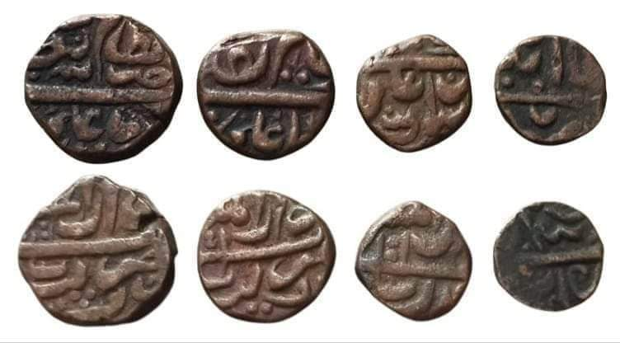

Slide 8
Parenda
This resistance from Malik Amber ended with his death in 1626. His son Fath Shah did try to continue the resistance but Shah Jahan’s deccan campaign snuffed the life out of the Nizamshahi empire in 1633.
Parenda did not mint coin in the reign of Shah Jahan in any metal.
A Mughal mint started minting activities in silver/gold coins during the end of Aurangzeb reign.
No coin of Aurangzeb in copper was known until recently when was discovered. No dates can be seen but with clear mint name of Parenda

Slide 9
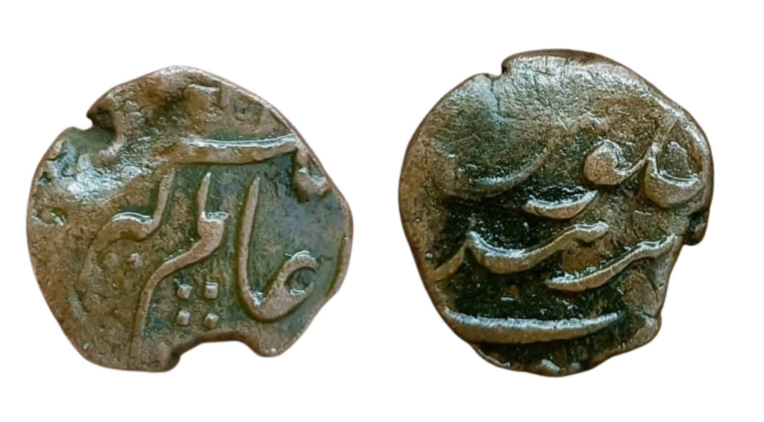
Aurangzeb Parenda

Slide 10
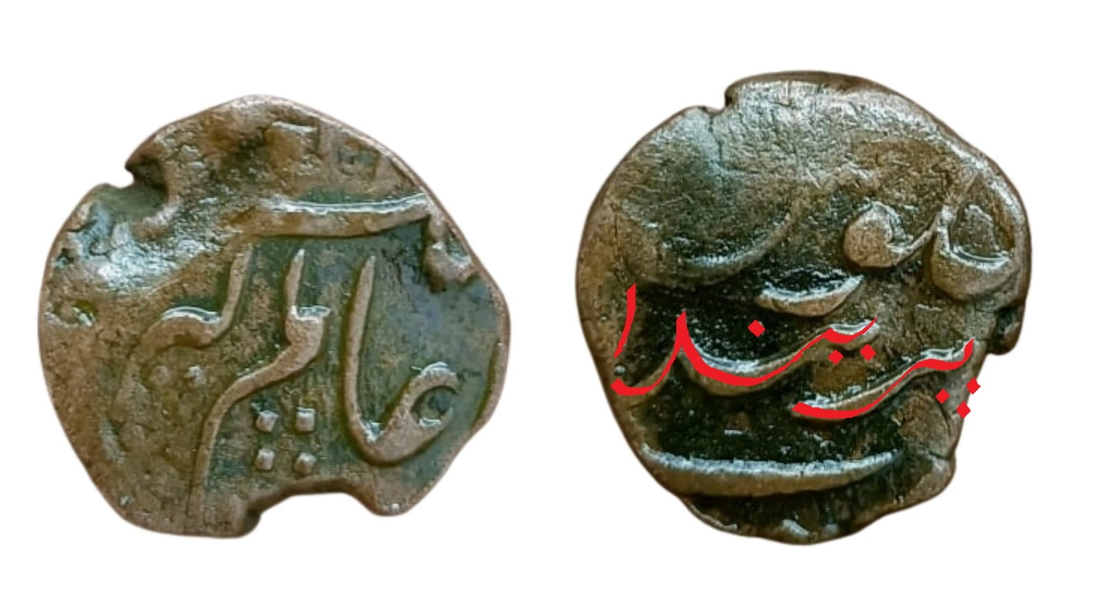

Slide 11
Parenda
Coins were minted in the name of all successive rulers till Muhammad Shah and the subsequent slides will illustrate them.
The copper coin production seems to be sporadic with the most number of copper coins found during the reign of Shah Alam I and Farrukhsiyar while it decreases later.
Jahandar Shah ruled for less than a year and hence the coins are rare
Recently a half paisa of Shah Jahan II (Rafi ud daula) was discovered who rued for about 3 months

Slide 12
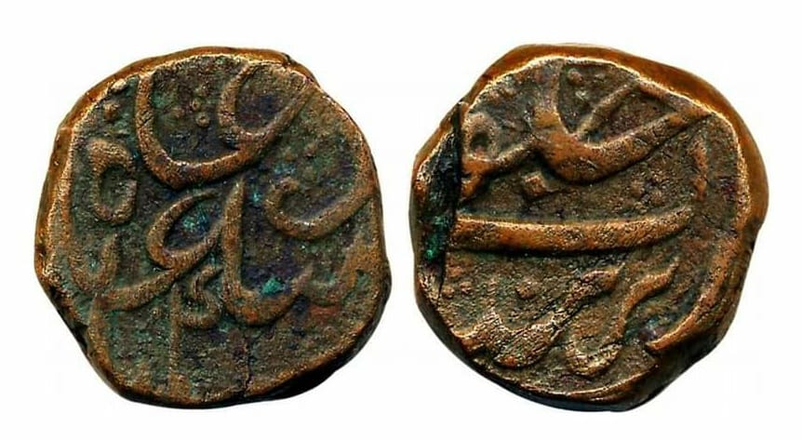
Shah Alam I - Parenda

Slide 13
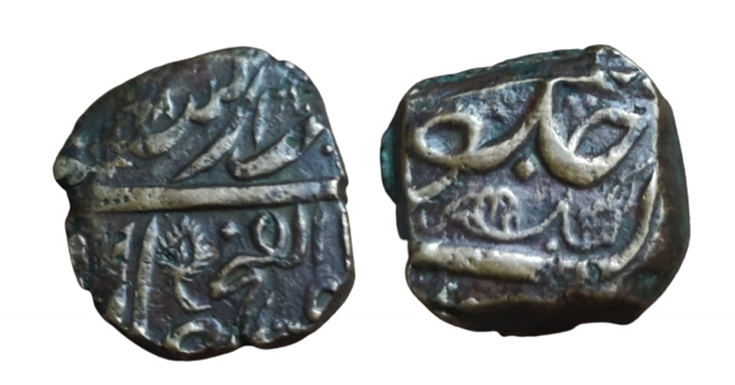
Jahandar Shah - Parenda

Slide 14
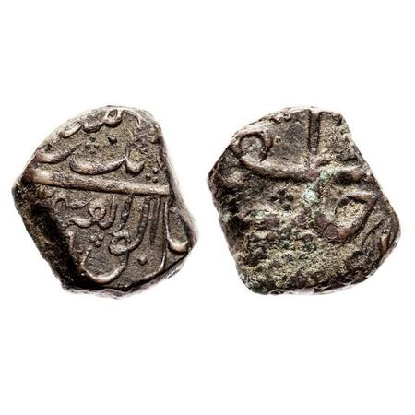

Slide 15
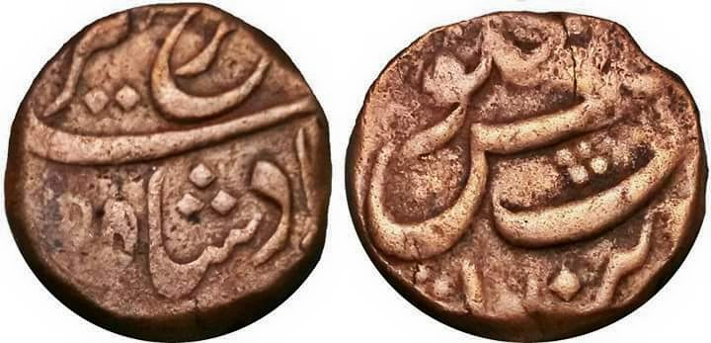
Farrukhsiyar - Parenda

Slide 16
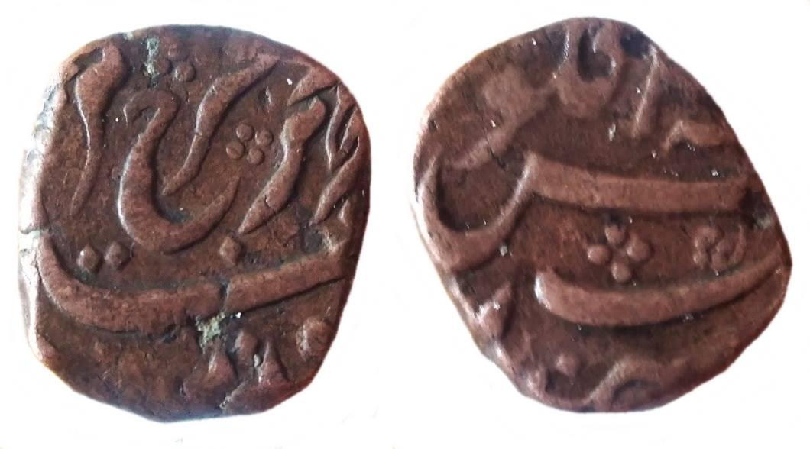
Farrukhsiyar Parenda- Couplet

Slide 17
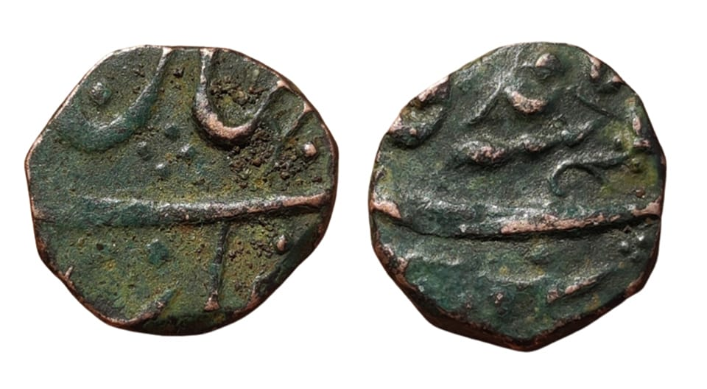
Shah Jahan II- Parenda

Slide 18
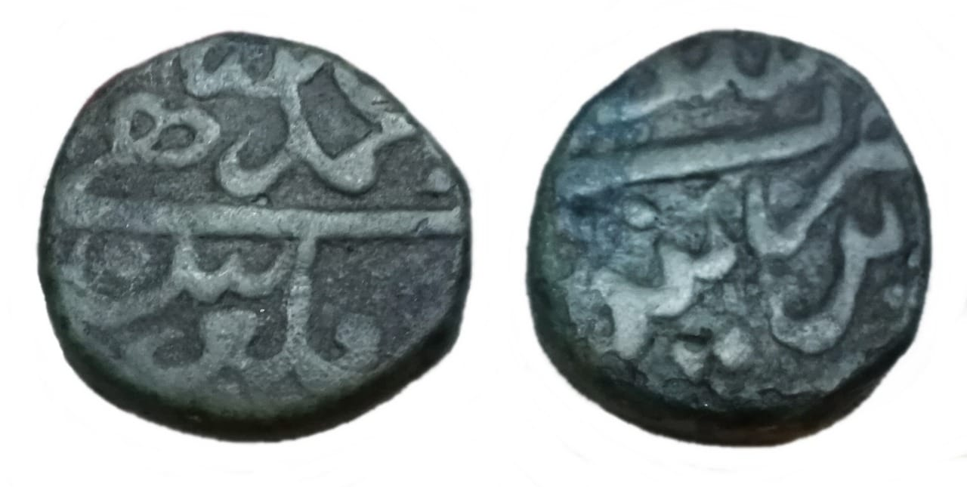
Muhammad Shah- Parenda

Slide 19
Nizam of Hyderabad- Parenda
So the mint passed hands from the Mughals to it’s independent governor- The nizam of Hyderabad
The coins of Parenda post dating the secession of Asaf Jah I in 1724 should be regarded as under the Nizam of Hyderabad.
The coppers are rare and one was offered in Todywala auction in 2011. One happens to be in my collection is illustrated. The coin is dated as (11)46AH corresponding to 3-6-1733 to 23-5-1734

Slide 20
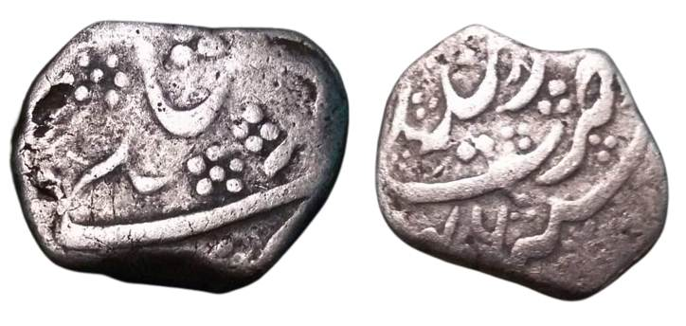
Nizam Of Hyderabad- Parenda

Slide 21
Nizam of Hyderabad- Parenda
It should be noted a similar copper coin was published by Dilip Balsekar and Sanjay Sahdev as ‘Purandar’ mint and attributed to Marathas (Purandar- A new Maratha mint, IIRNS newsline- 2005) . It is due to the fact the fact the ending ‘alif’ is more curved giving an appearance of ‘re’
The copper coin of Alamgir II is so far unique and the ruler is written as Alamgir sani or second Alamgir. No date is seen but a similar unique siler is known dated ry4. It that case the ruler is the weakling Salabat Jung

Slide 22
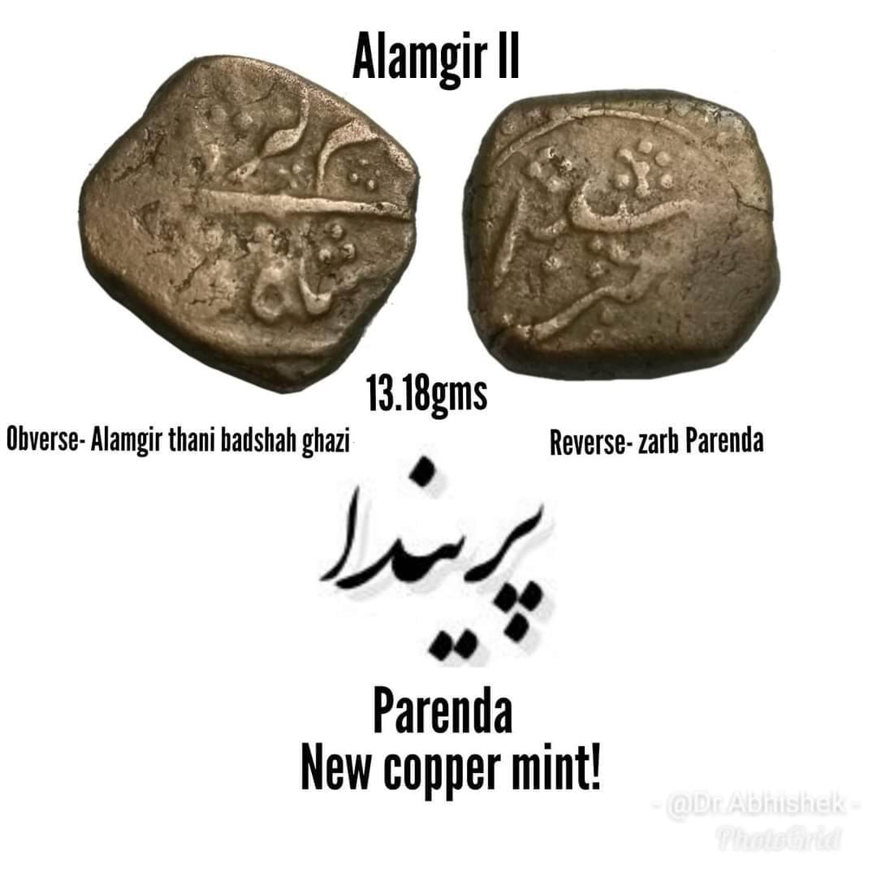
Alamgir II- Nizam

Slide 23
Reference
1) Kingdom of Ahmednagar- Radhey Shyam 2008 ,
2) Coinage of Nizams of Hyderabad- New discoveries and reattribution by Shailendra Bhandare- 2011.

Slide 24
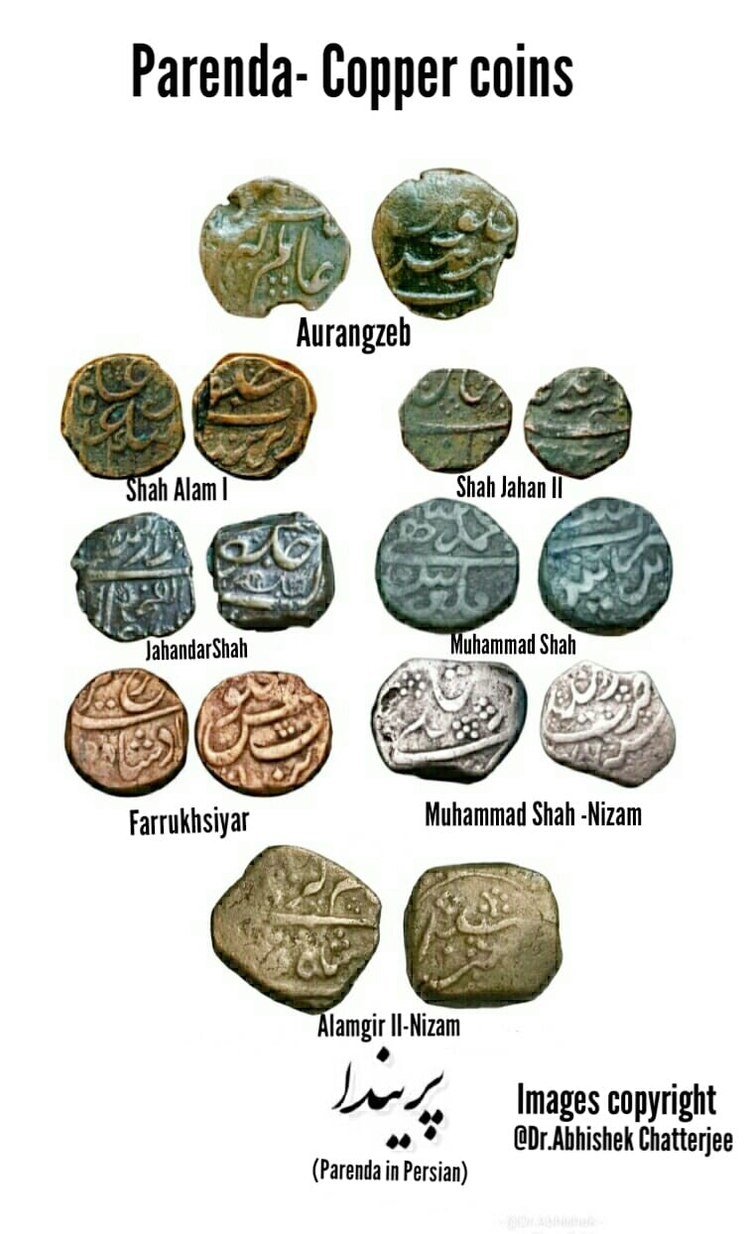
Thank you!!

